Slide 1


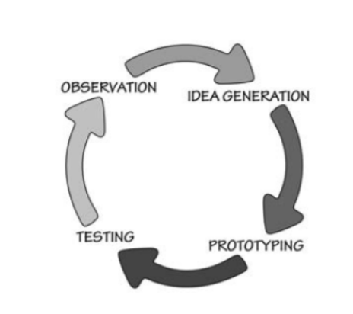
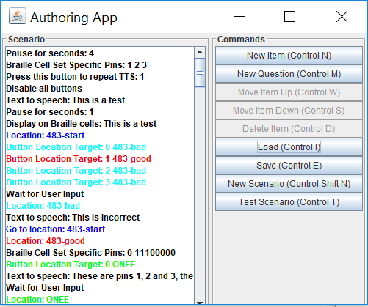
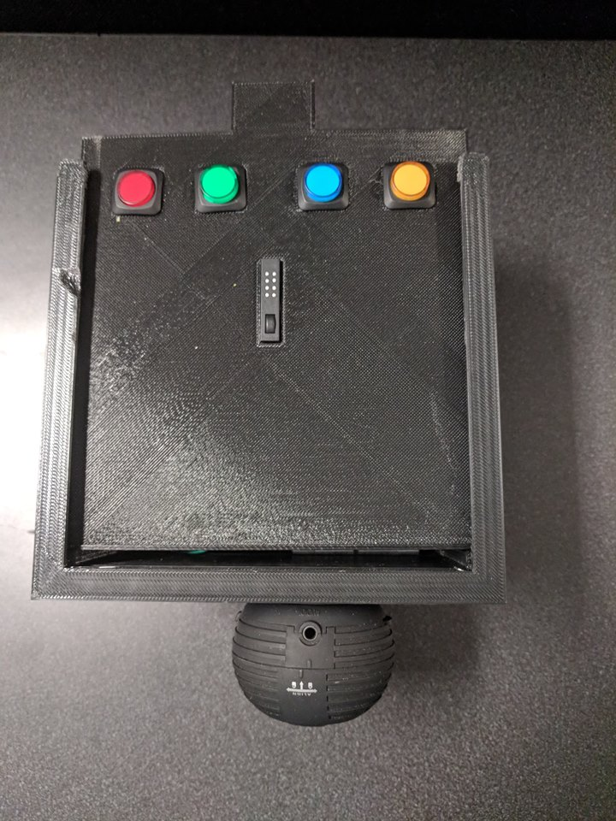
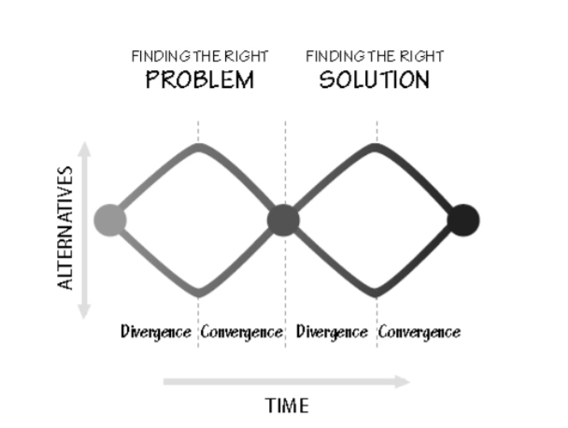
ENAMEL Project Authoring App - Treasure Box Braille ⠠⠁⠥⠹⠕⠗⠬⠀⠠⠁⠏⠏⠀⠤⠀⠠⠞⠗⠂⠎⠥⠗⠑⠀⠠⠃⠕⠭⠀⠠⠃⠗⠇ EECS 4080 – Capstone By: Gauri Wahi
Background
The Treasure Box Braille (TBB) project is designed to help support the learning of early-level Braille to children in North America. The project is part of the ENAMEL project that focuses on low-cost DIY technologies.
The authoring app is an open source software used to create scenarios for individuals to test their knowledge in Braille
Contains a simulator to demonstrate which pins will be raised and lowered on the Braille cell
Allow users to create scenarios and test their knowledge about what character is being displayed on the Braille cell
Several functionalities are available such as converting text-to-speech, display text, pause, set voice (either male or female), etc.
Once the scenarios have been created they can be transferred to the Raspberry Pi for the children to test their knowledge on the physical device.
Methodology
There are many different phases when it comes to testing. The steps we took were as follows:
Smoke testing – ensuring that the application did not have any minimal problems, e.g., if the methods implemented are working as planned
Regression testing – Whenever a software change has occurred we ensure that none of the old bugs have come back and note any new bugs that may have appeared
Acceptance Testing – allowing our target user to use the software in the lab to see if any problems arise or any feedback
Alpha testing – this is a test being conducted by our team to see if we can fix any of the bugs using the steps above before sending it off to different users to gain their perspective
Using the feedback received we would revise the program and continue the same process
Smoke Testing
Regression Testing
Acceptance Testing
Alpha Testing
Beta Test
Results
The bugs encountered using the methods above have been solved and now we are preparing to go to the next round – beta testing. The aim of the testing was to be able to let individuals with no programming background be able to use the application efficiently and to be able to create scenarios and test them as well. Working with one of our intended users, Runa Patel, we were able to narrow down what should be added and removed such as:
Improving the simplicity of the program by allowing the user to easily input functionalities into their scenarios such as Pause, Display Text, Raise/Lower Pins on the Braille Cell, etc.
Removed options that required the user to know advanced knowledge such as inserting the file path
Ensured it was working correctly with screen readers e.g., JAWS, NVDA, etc. so individuals with visual impairment can easily navigate through the program and complete tasks
References
1.“Acceptance Testing.” Software Testing Fundamentals, 3 Mar. 2018, softwaretestingfundamentals.com/acceptance-testing/.
2. “Alpha vs. Beta Testing.” Centercode Alpha vs Beta Testing Comments, www.centercode.com/blog/2011/01/alpha-vs-beta-testing.
3. “Biltzerpos/TBB.” GitHub, github.com/biltzerpos/TBB.
4. “The Braille Literacy Crisis in America.” Nation by the National Federation of the Blind Jernigan Institute, Mar. 2009, nfb.org/images/nfb/documents/pdf/braille_literacy_report_web.pdf.
5. “Smoke Testing.” Software Testing Fundamentals, 29 Jan. 2018, softwaretestingfundamentals.com/smoke-testing/.

